Slide 1
Leeds
A city in northern England (UK), It is located about halfway between London and Edinburgh. in West Yorkshire, the city is located at the foot of the Pennine Mountains, on the River Aire.

Slide 2
History
The name of this city comes from the old Brythonic word Ladenses, which means "people of the fast-flowing river", referring to the River Aire, which flows through the city. The name referred to the wooded area covering most of the Brythonic kingdom of Elmet, which existed in the 5th century until the early 7th century.
Leeds was also the capital of the Britons in the seventh century, a medieval center of trade and got its first privileges in 1207 and city rights from 1626. In the fourteenth century, an important center of textile (wool).

Slide 3
Tourism and monuments
The most important attractions and monuments are:
City hall, cathedral, Abbey House Museum – Victorian shops, Armley Mills Museum – industrial history in Leeds, Tetley BreweryCorn Exchange – former corn exchange, Elland Road – Leeds United Stadium, Kirkstall Abbey – Cistercian monastery, Royal Armouries – Museum of Weapons, West Yorkshire Playhouse – one of the most important theatres in Great Britain, Victoria Quarter, Tropical world and Leeds Art Gallery.

Slide 4
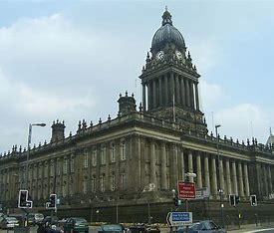
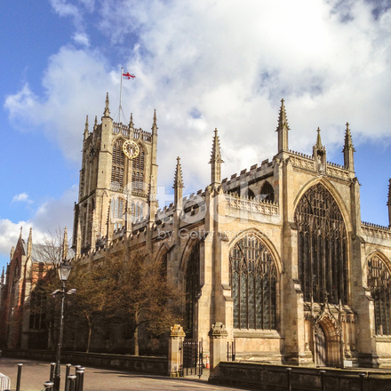
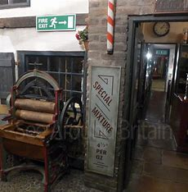
Abbey House Museum – Victorian shops
City hall
Cathedral

Slide 5
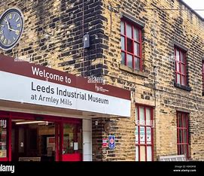
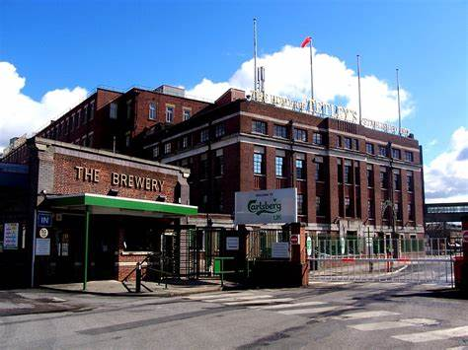
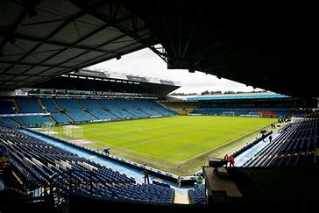
Armley Mills Museum – industrial history in Leeds
tetley BreweryCorn Exchange – former corn exchange
Elland Road – Leeds United Stadium

Slide 6
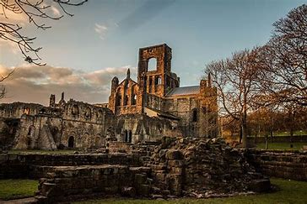
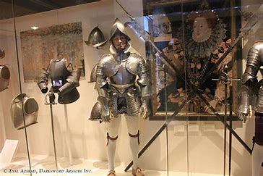
Royal Armouries – Museum of Weapons
Kirkstall Abbey – Cistercian monastery

Slide 7
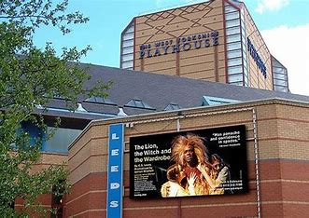
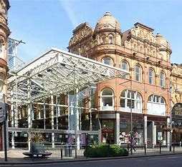
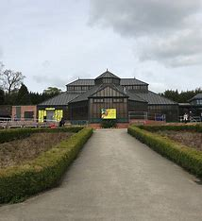
West Yorkshire Playhouse – one of the most important theatres in Great Britain
Victoria Quarter
tropical world

Slide 8
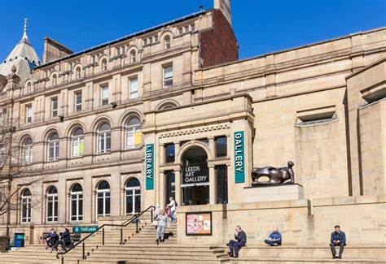
Leeds art gallery

Slide 9
Notable people associated with Leeds
Barbara Taylor Bradford – a writer born in 1933 in Leeds, is one of the richest writers in the world. Her fortune is estimated at £166 million.
Zygmunt Bauman – Polish sociologist, philosopher, essayist. From 1971 he lived in Leeds, remaining associated with the university there.
Andrew Eldritch (real name Taylor), frontman and founder of Leeds-based band Sisters of Mercy.
Matthew Lewis, an actor who played Neville Longbottom in the Harry Potter films
Mel B (born Melanie Brown, 29 May 1975) is an English singer, actress and television presenter, best known for her work in the Spice Girls under the stage name Scary Spice.
Sam Riley is a film actor and musician born 8 January 1980 in Leeds, England. He currently lives in Berlin.
Malcolm McDowell (born 13 June 1943) is an English actor and producer.
Sue Ryder (3 July 1923 – 2 November 2000) was a British soldier and charity activist.

Slide 10
Dziękuję za oglądanie

Slide 11
Wiktoria Woźniak

