Slide 1
easter
traditions and symbolsI

Slide 2
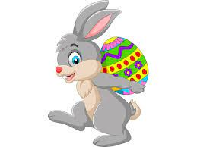
The ester bunny
In Western Europe, the hare is treated as an amulet, just like black cats. Easter bunnies mate and are considered a sign of fertility. That's why they are given to children during Easter breakfast.

Slide 3
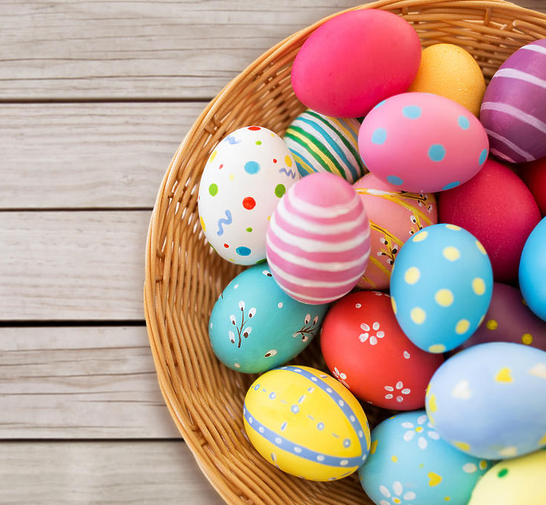
Easter egg
The egg is widely known as a symbol of new life and rebirth, which is why it is included on the Easter table. Decorated eggs reflect the colors associated with spring and hope resulting from faith in the resurrection.

Slide 4
EASTER BASKET
Easter basket is of great importance in the Catholic tradition. It is a symbol of Resurrection and Life, salvation that is achieved through Jesus' sacrifice on the cross. This is why we put certain foods in the Easter basket: lamb, bread, salt, pepper, eggs, cold cuts, horseradish.

Slide 5
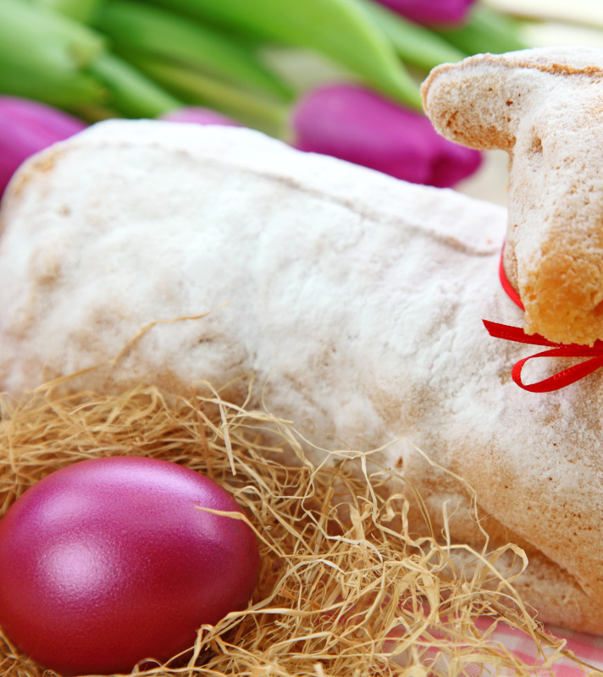
Easter lamb
Lamb - is an important symbol for Christians because it means redemption of sins and overcoming evil. It is most often found on the Easter table in the form of a chocolate or sugar figurine.

Slide 6
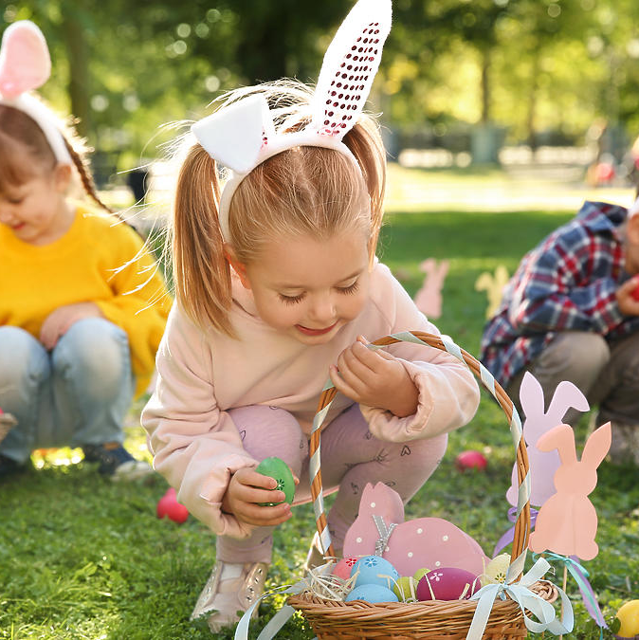
looking for Easter eggs
Every year, children in many parts of the world joyfully search for chocolate eggs carefully hidden by the Easter Bunny, thanks to a tradition that began in Germany.

Slide 7
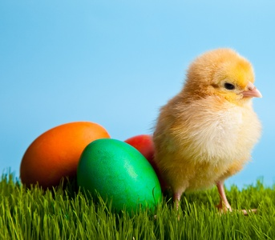
The tradition of placing a chicken in a basket probably has rural roots because the hosts wanted to emphasize the importance of the birth of a new life and spring, which, of course, corresponds perfectly with Easter.
Easter chicken

Slide 8
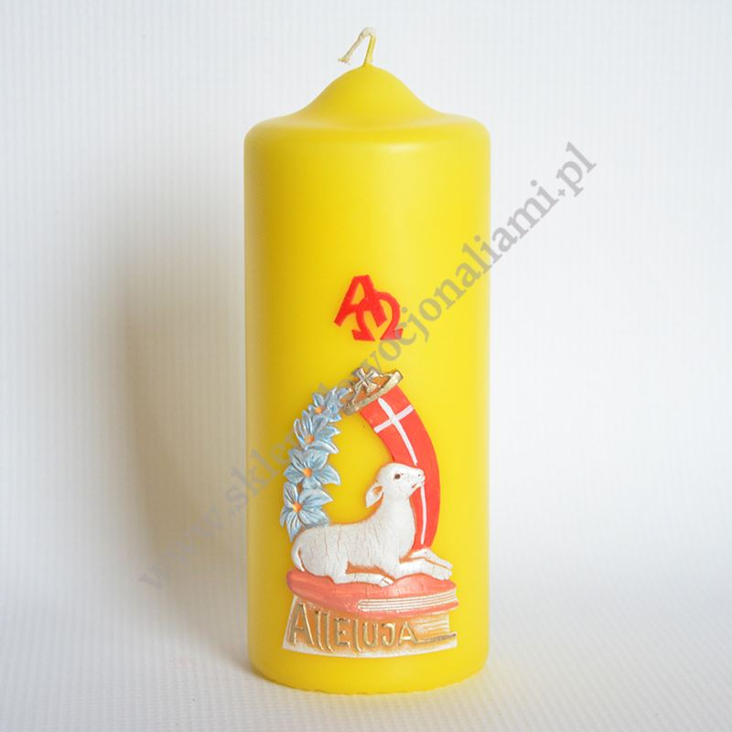
Easter candle
Easter candle - fire symbolism The fire coming from the candle plays a very important role in Easter rituals. It is considered a sign of the resurrection of Jesus, symbolizing strength, survival, purification and the victory of light over darkness.

Slide 9
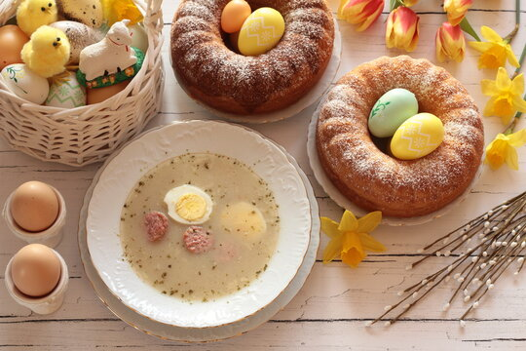
According to tradition, all dishes should be tasted during this festive meal. The table must include sour soup with white sausage, cold meats, mazurka cake and Easter cake. Before you taste all the delicacies, share the egg with your loved ones and wish each other Christmas wishes.
Easter breakfast

Slide 10
Amelia Dudek kl. 5B

