Slide 1
Supply, Demand, and Market Equilibrium Príloha č. 2

Slide 2
Market Demand Curve: A curve showing the relationship between price and quantity demanded by all consumers together, ceteris paribus.
Market demand is the sum of the quantities demanded by all consumers in the market, or the sum of individual demand curves.

Slide 3
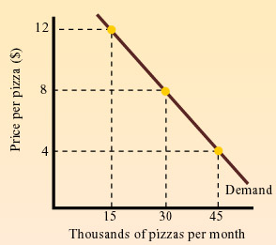
The Market Demand Curve and The Law of Demand

Slide 4
The main determinants of demand
include:
The price of the product
Consumer income
The price of related goods—substitutes and complements
The number of consumers
Consumer preferences—tastes and advertising
Consumer expectations about future prices

Slide 5
Market supply
Market supply is the total amount of an item producers are willing and able to sell at different prices, over a given period of time e.g. one month

Slide 6
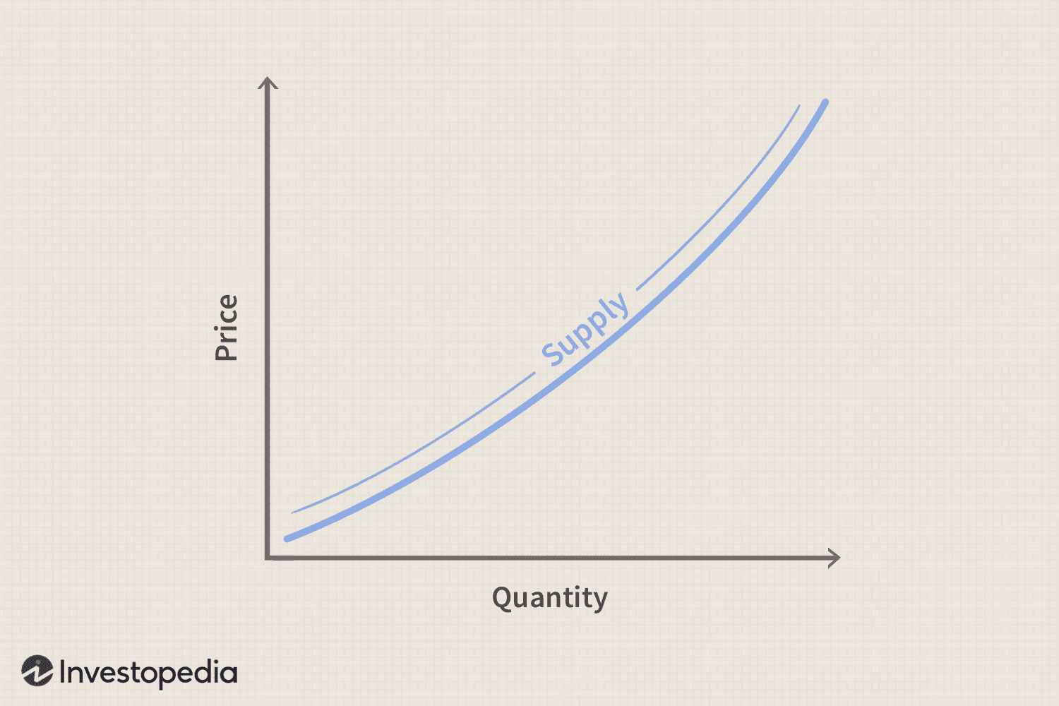
The supply curve shows the relationship between price and the quantity that producers are willing to sell during a particular time period, all else being equal.

Slide 7
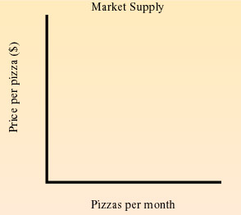
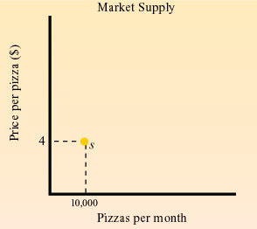
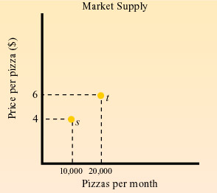
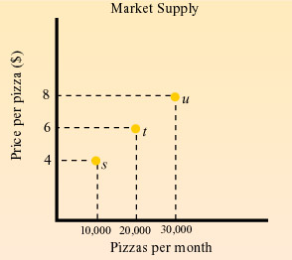
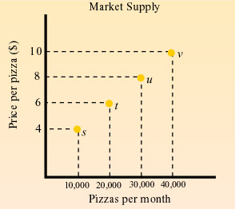
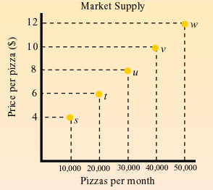
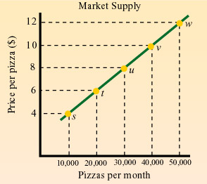
the law of supply –video.The higher the price, the larger the quantity supplied.

Slide 8
The main determinants of supply include:
The cost of inputs
The state of production technology
The number of producers
Producer expectations about future prices
Taxes or subsidies from the government

Slide 9
Price per pizza € | Qauntity demanded | Quantity supplied | Result
12 | 15 000 | 50 000
10 | 23 000 | 40 000
8 | 30 000 | 30 000
6 | 37 000 | 20 000
4 | 45 000 | 10 000

Slide 10
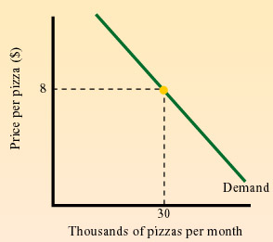
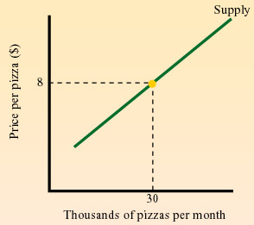
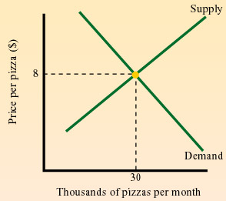
Market Equilibrium
Market equilibrium is a situation in which, at the current market price, quantity supplied equals quantity demanded.
When the market is in equilibrium, there is no tendency for the price to increase or decrease.

Slide 11
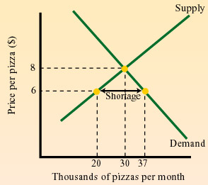
Shortage: excess quantity demanded
Excess Demand (Shortage) : A situation in which consumers are willing to buy more than producers are willing to sell. It occurs when market price is lower than equilibrium price.

Slide 12
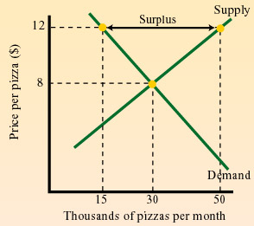
Surplus: excess quantity supplied
Excess Supply (Surplus): A situation in which producers are willing to sell more than consumers are willing to buy. It occurs when market price is above equilibrium price.

Slide 13
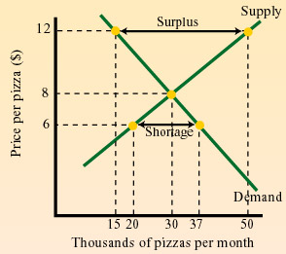
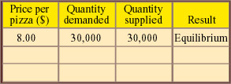
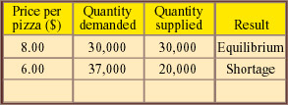
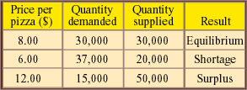
Equilibrium and Disequilibria

