Slide 1
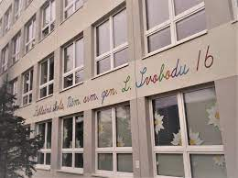
My school

Slide 2
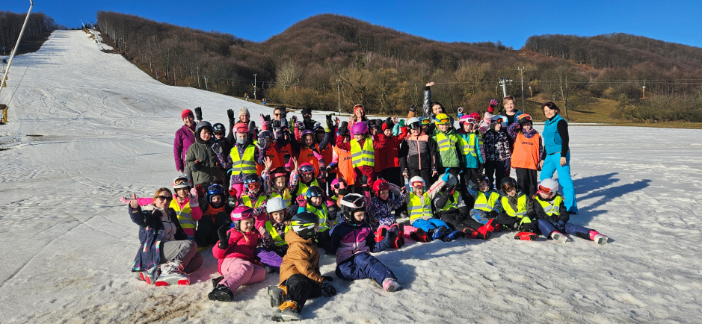
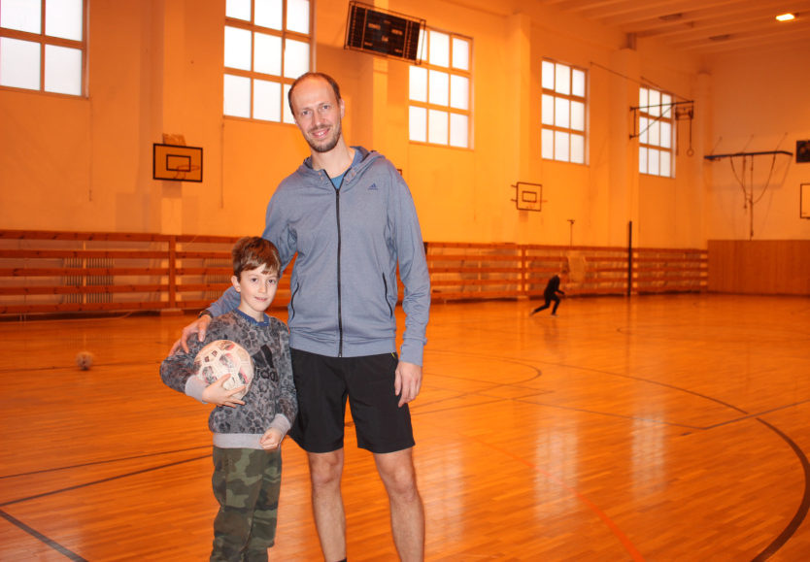
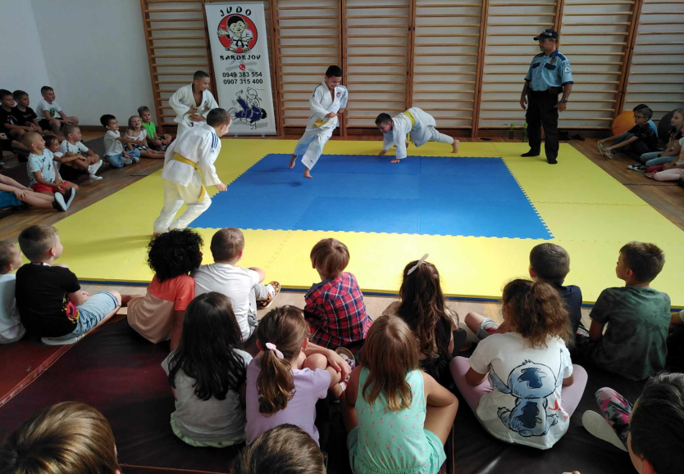
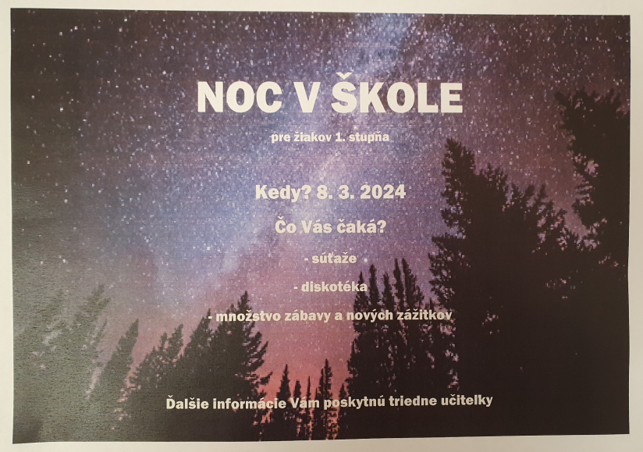
Activities
Ski training →
← Swimming pool
↑ Day Family
↑ Judo
↑ Night in school

Slide 3
Timetable 5.A
 | 1. | 2. | 3. | 4. | 5. | 6.
MONDAY | MAT | GEO | AJ | SJAL | TAŠV | HV
TUSDAY | BIO | VV | VV | MAT | SJAL
WEDNESDAY | TECH | SJAL | AJ | MAT | TAŠVP
THURSDAY | BIO | SJAL | DEJ | TAŠV | MAT
FRIDAY | INF | AJ | GEO | SJAL | MAT

Slide 4
Class Teacher
Mária Kyjovská

Slide 5
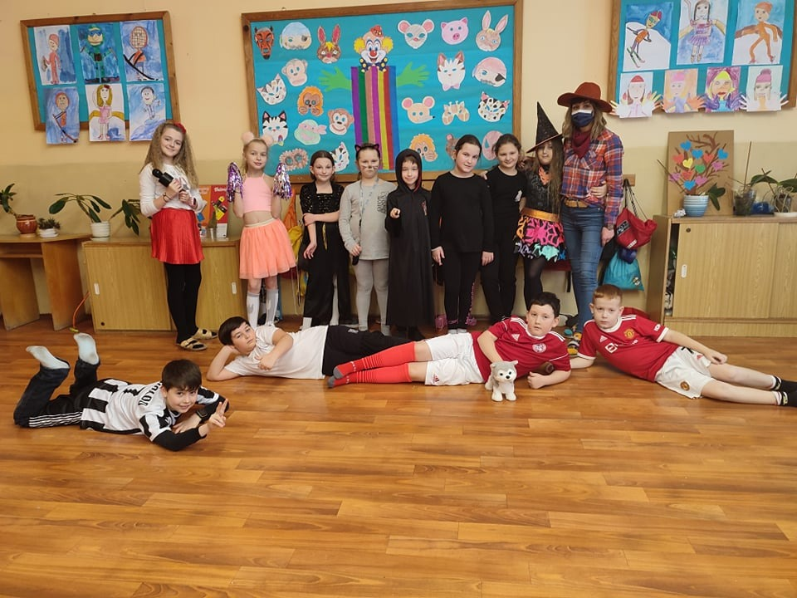
My Friends in Class

