Slide 1
TVRDÉ
SPOLUHLÁSKY
Mgr. Danka Spišáková

Slide 2
Tvrdé spoluhlásky sú:
H
CH
G
K
L
D
T
N
SPOLUHLÁSKY
PREHĽAD
SLABIKY
CVIČENIE
KONIEC

Slide 3
H

Slide 4
CH

Slide 5
K

Slide 6
G

Slide 7
D

Slide 8
T

Slide 9
N

Slide 10
L

Slide 11
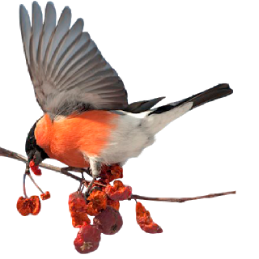
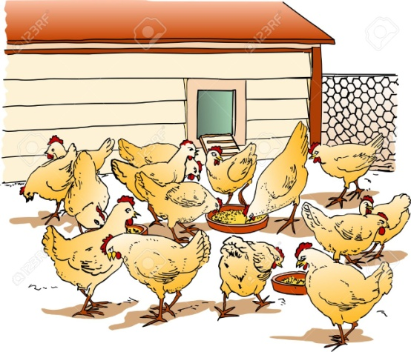
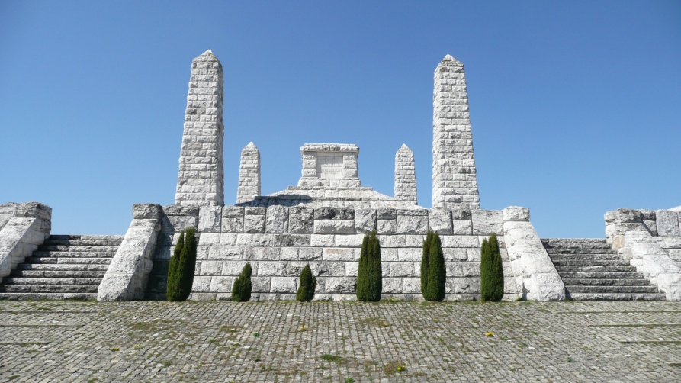
hydina
hymna
hýľ
H
hynúť
pohyb
mohyla

Slide 12
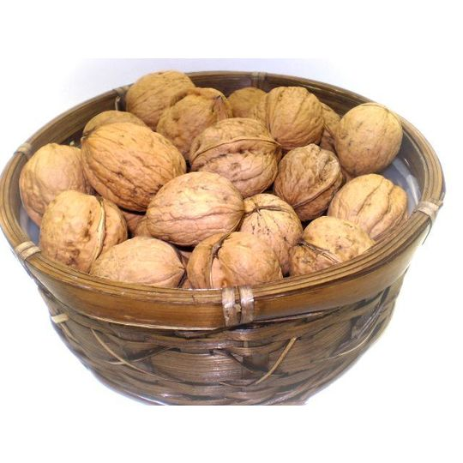
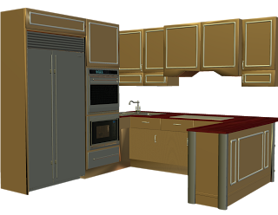
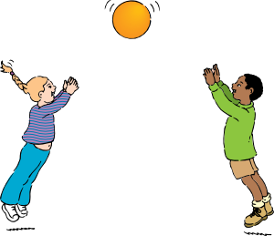
orechy
chyžná
kuchyňa
CH
chytať
chytro
chyba

Slide 13
kytica
kyjak
jaskyňa
K
kysnúť
kyslé
kývať

Slide 14
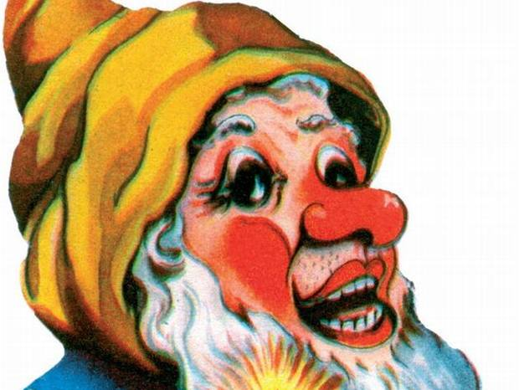
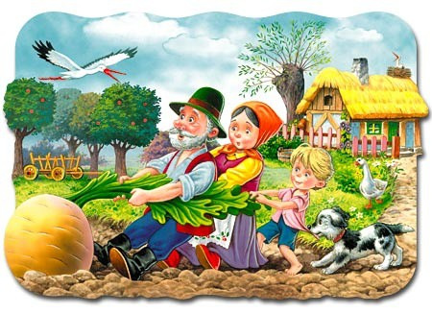
gyps
gýč
burgyňa
G
gymnázium
gymnastika

Slide 15
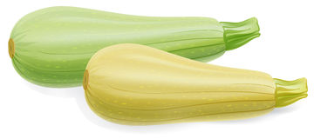
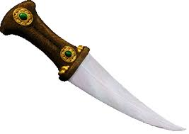
dym
dýchať
dyňa
D
dych
dýka
dynamit

Slide 16
dotyk
týždeň
motýľ
T
štyri
tyčinka
motyka

Slide 17
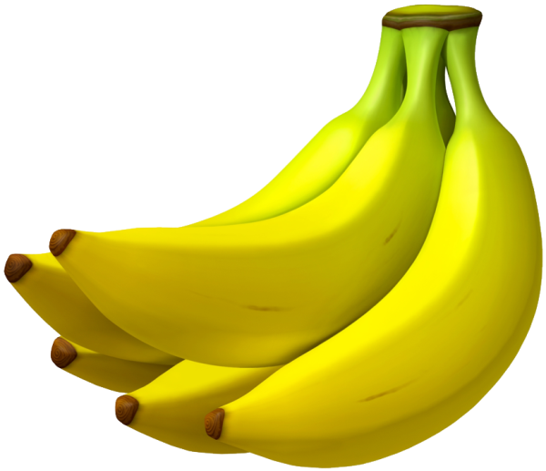
pekný
noviny
zelený
N
zvony
nylon
banány

Slide 18
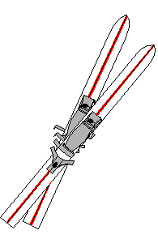
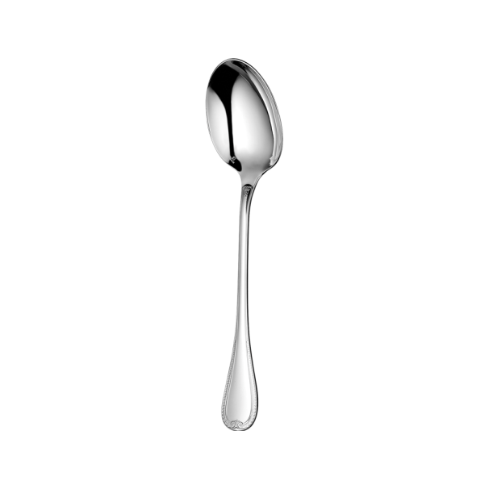
lyže
mlyn
lyžica
L
lýtko
plytký
blýskať sa

Slide 19
hy

Slide 20
chy

Slide 21
ky

Slide 22
gy

Slide 23
dy

Slide 24
ty

Slide 25
ny

Slide 26
ly

Slide 27
l_žiar
lyžiar
zošit_
stany
zošity
stan_
hluch_
hluchý
steh_
stehy
periny
perin_
Precvič si písanie y/ý.
príbehy
vtedy
príbeh_
vted_
všetk_
všetky
muchy
g_mnastka
much_
k_slík
gymnastka
kyslík

Slide 28
Nauč sa naspamäť tvrdé spoluhlásky.
Pekný deň.
16:04

Slide 29
ZDROJE:
http://www.corgan75.com/images/objects/1948-1958/chalk.png - krieda
http://tluif.home.xs4all.nl/Humor/moomoo.jpg - hydina
http://cartoon-birds.clipartonline.net/_/rsrc/1426940532976/bullfinch-bird-images/Bullfinch%20Eating%20Fruit%20On%20A%20Branch.png?height=320&width=320 – hýľ
http://commondatastorage.googleapis.com/static.panoramio.com/photos/original/54224897.jpg - mohyla
http://www.karin-matsugishi.com/images/material/item_XXL/110-m.jpg - orechy
https://encrypted-tbn1.gstatic.com/images?q=tbn:ANd9GcTE13GudK2V0qWemBjGdtsJBTSjQY1hAuXnzw9hdUjGA-17n-HFrw – chyžná
http://2.bp.blogspot.com/-OE6W-9k3a-A/TteJwwUwnMI/AAAAAAAAFr4/nu051iGOXhQ/s320/R11+-+Kitchen+Stuff+Bonus+-+020.png – kuchyňa
http://worldartsme.com/images/catch-a-ball-clipart-1.jpg - chytať
http://foxarc.com/c-blog/wp-content/uploads/2014/12/Flower-Clipart-Bouquet-of-Orange-Tulips.png - kytica
http://www.party-store.sk/emdata/products/595_m.jpg?1 – kyjak
http://images.clipartpanda.com/cave-clipart-ncBXaAKBi.gif - jaskyňa
http://www.clipartbest.com/cliparts/9cR/gdX/9cRgdXGzi.png - kývať
https://openclipart.org/image/2400px/svg_to_png/217861/brokenleg-cast.png - sadra
http://ipravda.sk/res/2009/08/11/thumbs/22713-trpaslik-duk-ilustracne-gyc-nestandard2.jpg - gýč

Slide 30
http://www.sietovka.sk/wp-content/uploads/repa.jpg - burgyňa
http://classroomclipart.com/images/gallery/Clipart/Sports/Gymnastics_Clipart/TN_gymnastics_girl_balance_beam.jpg - gymnastika
http://lessonpix.com/drawings/37806/100x100/Smoke+like+a+Chimney.png – dym
http://thumbs.dreamstime.com/t/two-marrow-zucchini-white-background-37458716.jpg - dyňa
http://comunidad.movistar.es/t5/image/serverpage/image-id/42818i574E66871F1AEAB8/image-size/original?v=mpbl-1&px=-1 – dynamit
https://encrypted-tbn1.gstatic.com/images?q=tbn:ANd9GcRj532anAJJs2CamEVOhIN4xYtBDL1UFZHvC_JG79_daPeMbqhr – dýka
http://thumbs.dreamstime.com/t/save-your-breath-idiom-white-background-50510048.jpg - dych
http://www.clker.com/cliparts/k/o/6/7/7/c/number-4-dots-md.png - štyri
http://www.clker.com/cliparts/a/a/4/4/11971000532011391048johnny_automatic_hand_hoe_1.svg.hi.png - motyka
http://vignette2.wikia.nocookie.net/winx/images/4/4c/Purple_and_Blue_Transparent_Butterfly_Clipart.png/revision/latest?cb=20140118043757 – motýľ
http://www.cliparthut.com/clip-arts/101/wrapped-candy-clip-art-101400.png - tyčinka
http://worldartsme.com/images/finger-touch-clipart-1.jpg - dotyk
http://www.homestead.com/~media/elements/Clipart/household/newspaper1.gif - noviny
http://thndl.com/images/1_3.png - zelený
https://img1.etsystatic.com/103/0/11183516/il_340x270.846151085_74un.jpg - nylon
http://cdn.mysitemyway.com/etc-mysitemyway/icons/legacy-previews/icons-256/3d-transparent-glass-icons-culture/022057-3d-transparent-glass-icon-culture-bell-clear-sc30.png - zvony
http://pngimg.com/upload/banana_PNG819.png - banány
http://www.bestgraph.com/cliparts/sports/ski/ski-02.gif - lyže
http://images.clipartpanda.com/mill-clipart-4cbMMopdi.png - mlyn
http://pngimg.com/upload/spoon_PNG3035.png - lyžica
http://www.proprofs.com/flashcards/upload/q10498312.png - lýtko
https://pathwaytoascension.files.wordpress.com/2015/10/music-notes-clip-art-png-music.png - noty
http://www.celysvet.cz/skin/smile/s2064.gif - blýskať sa
http://www.bolos.sk/images/cache/5b53bde878fa2107bd85e487b5dc6025.gif - plytký tanier

