Slide 1
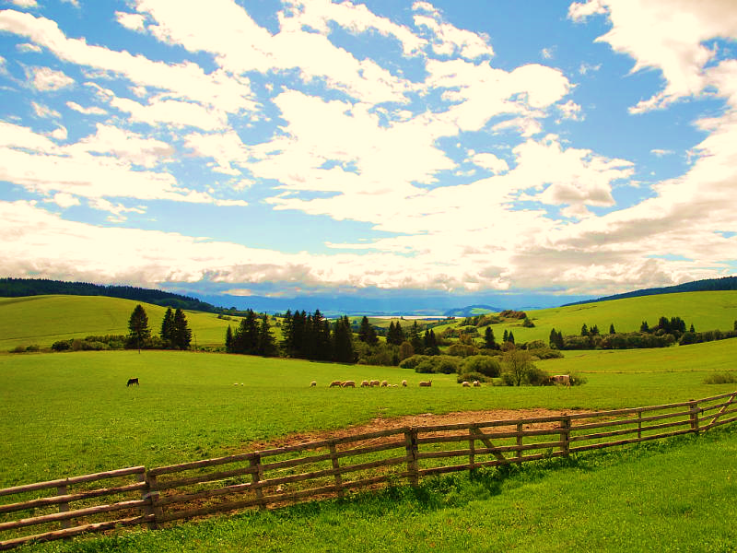
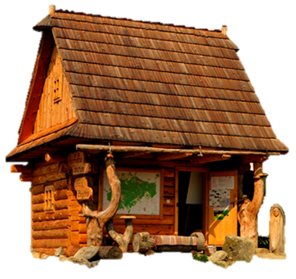
JEDLO
Slovakia
Simona Cabadajová, Jozef Hanuliak, Saša Jánošíková, Timea Krúpová, Tereza Pevná, Michaela Skopalová, Stanislava Somíková, Lukáš Vandlík

Slide 2
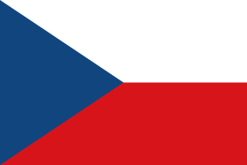
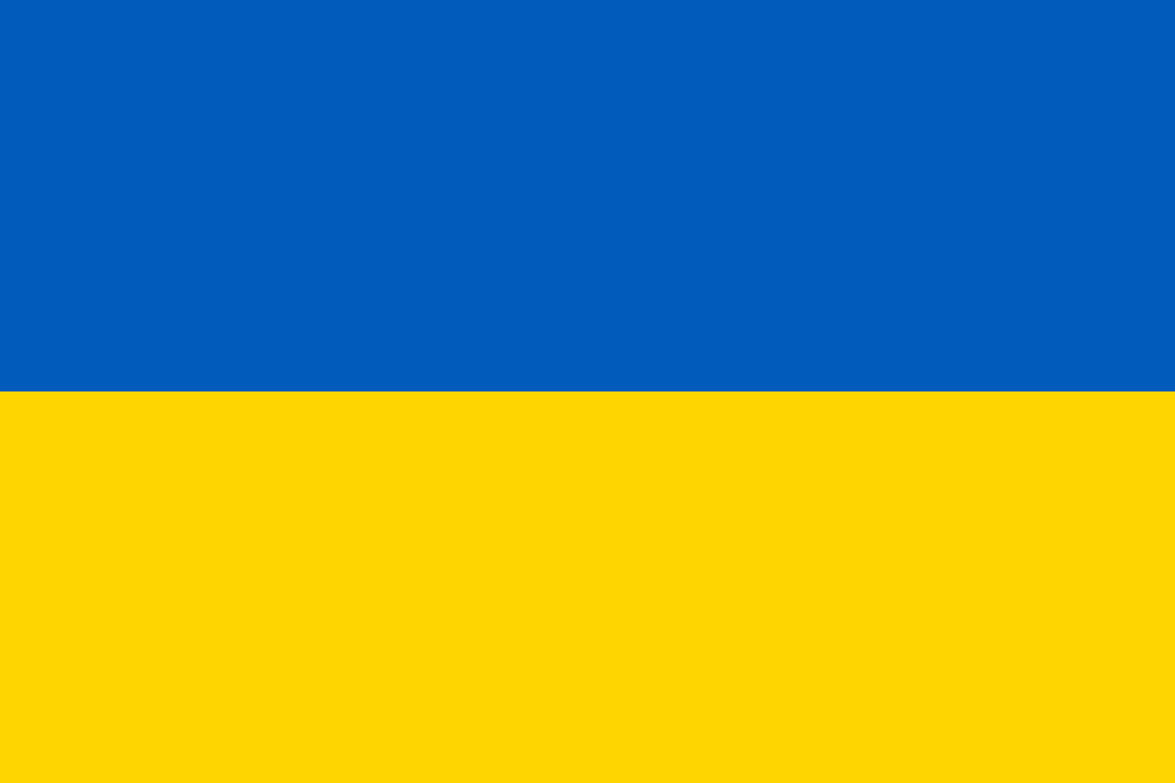
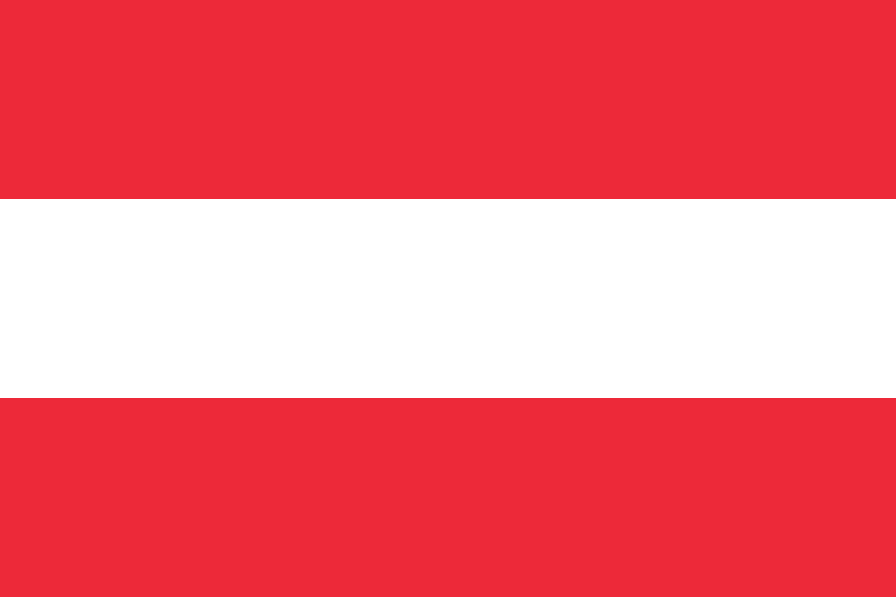
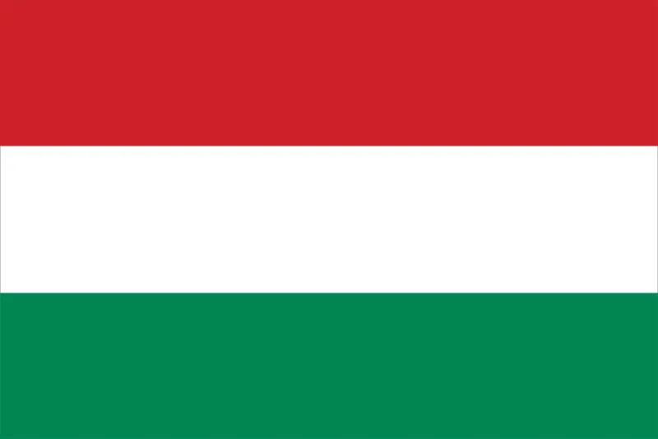
Neighbors

Slide 3
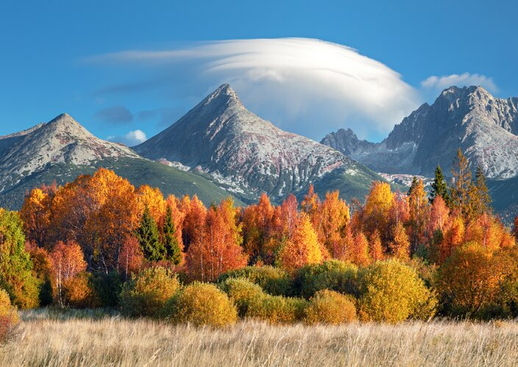
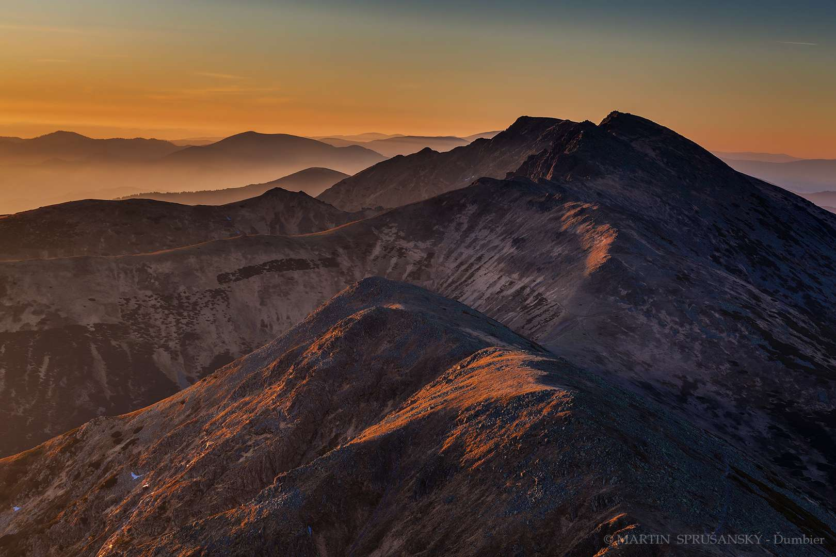
Tatras
There are High and Low Tatras
Gerlach Shield
Ďumbier
Located in High tatras
2665m height above sea
Highest mountain in Slovakia
Highest mountain in Low tatras
2043m height above sea

Slide 4
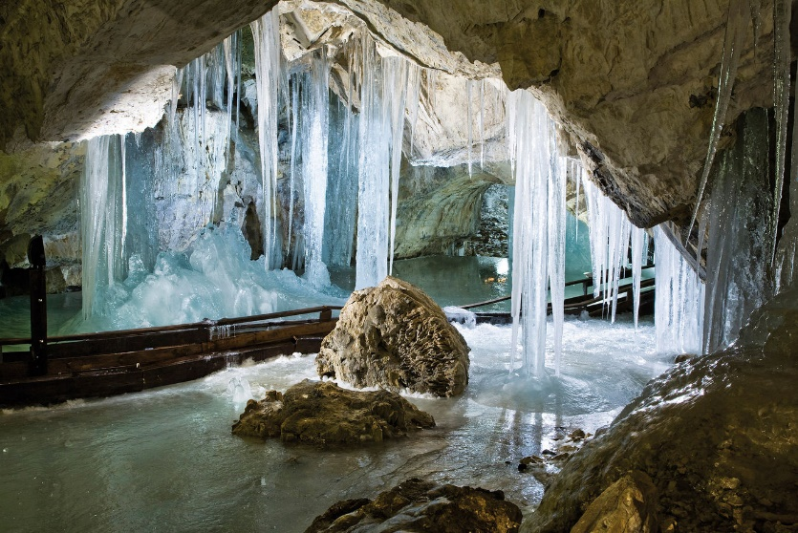
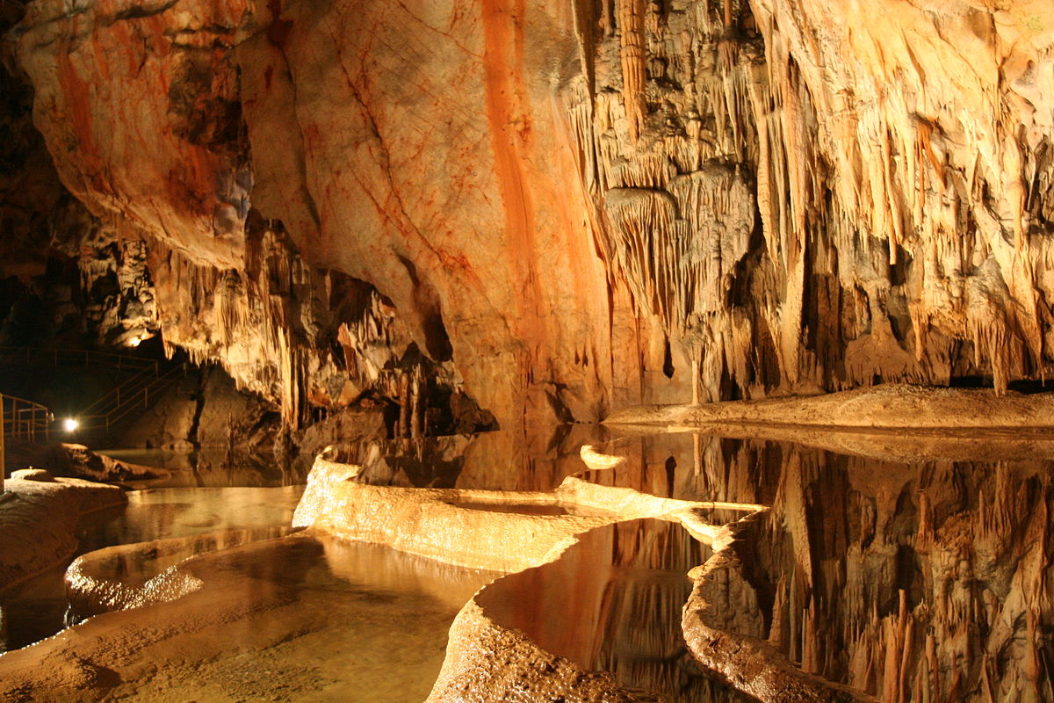
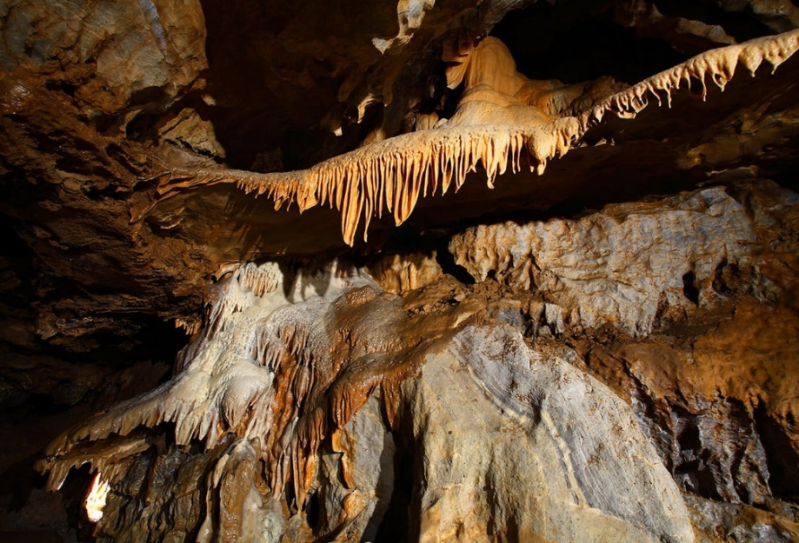
.
Caves
Demänovská ice cave
Domica
Bystrianska cave

Slide 5
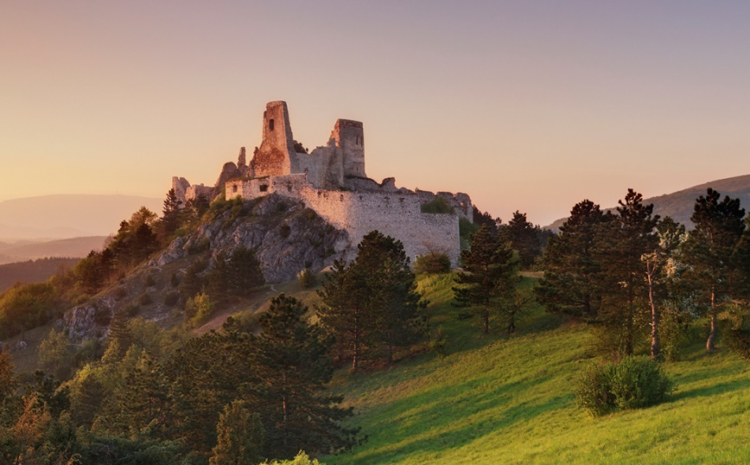
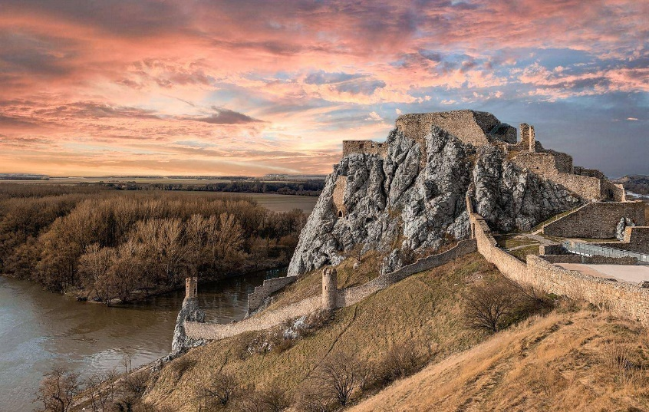
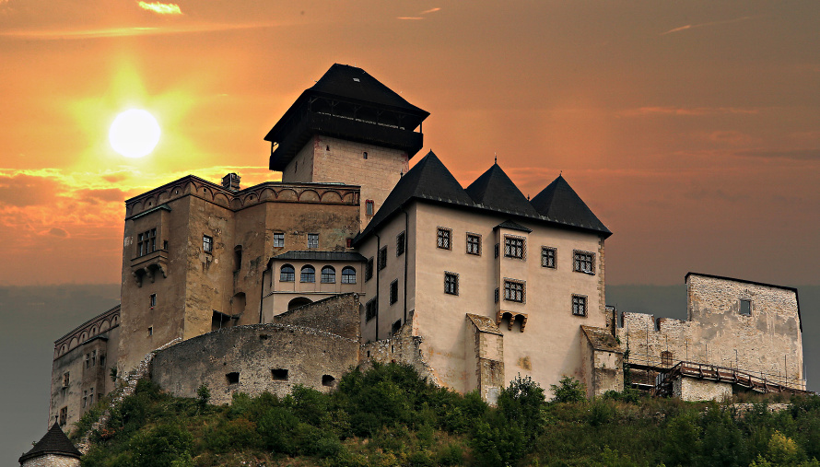
Castles
Čachtice castle
Devín
Trencin castle

Slide 6
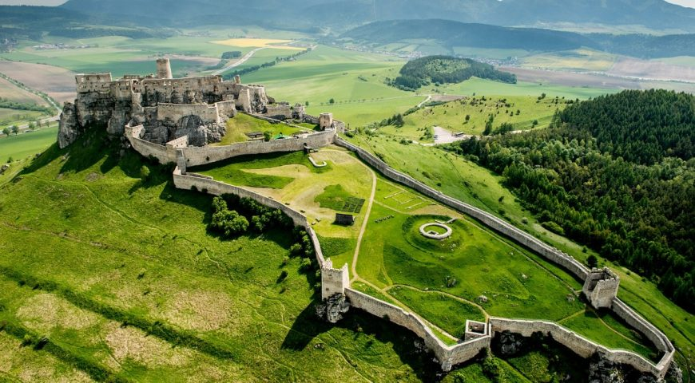
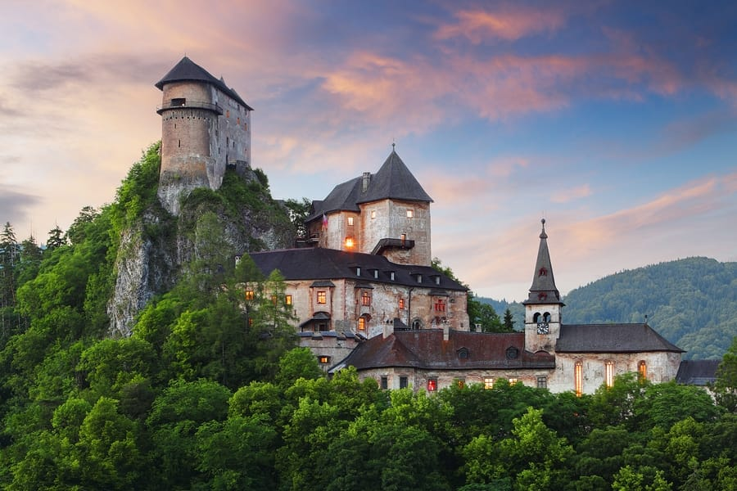
.
Castles
Bratislava castle
Spiš castle
Orava castle

Slide 7
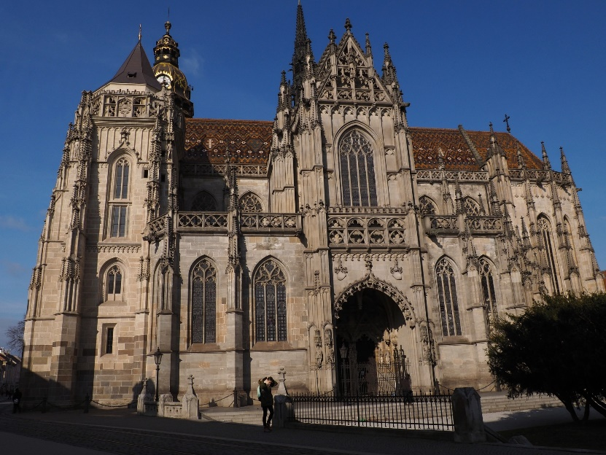
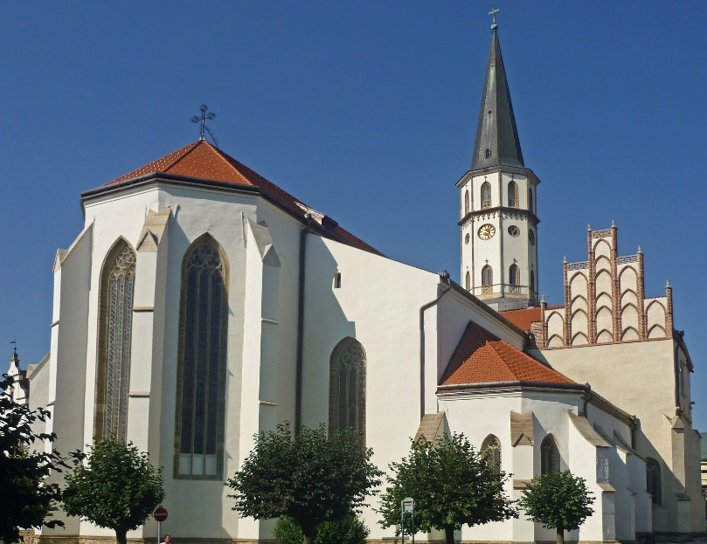
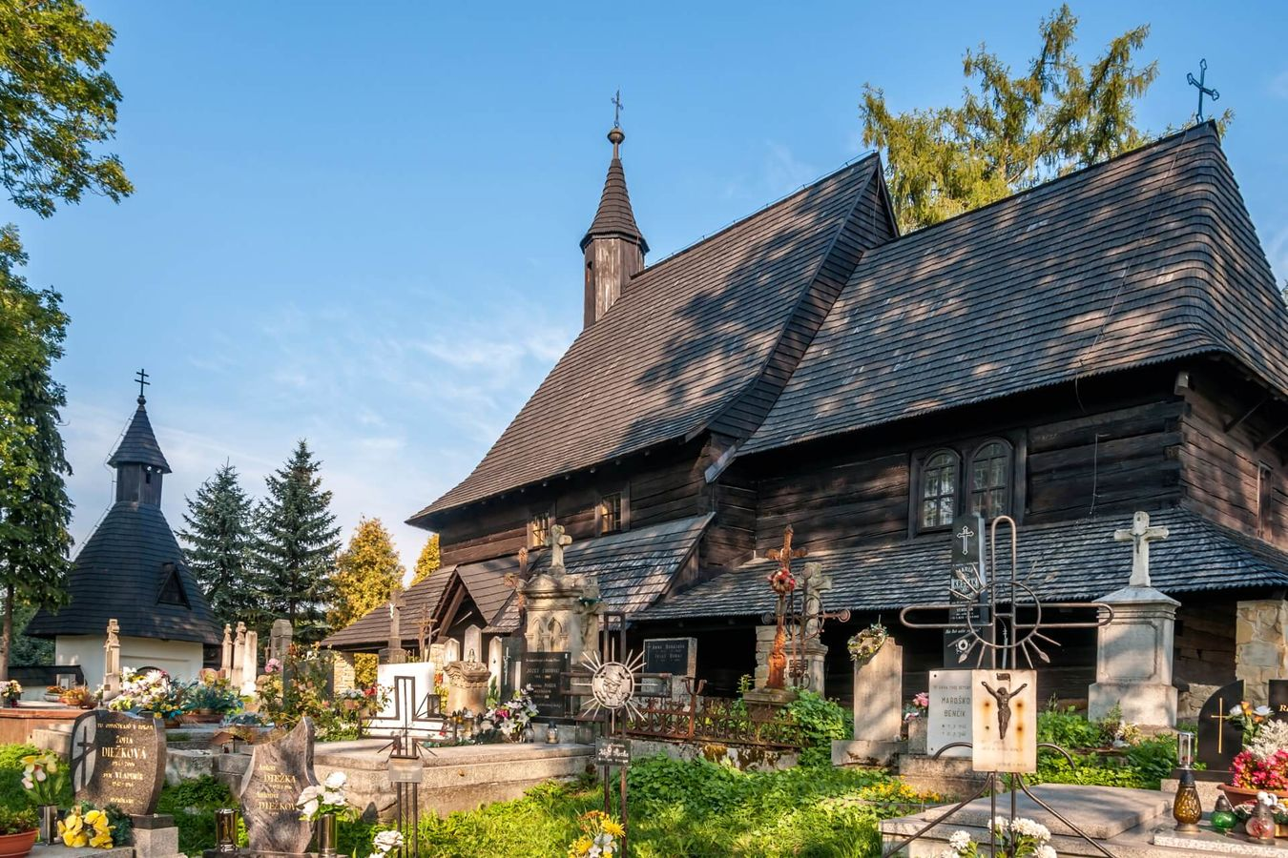
Churches
House of St Elizabeth
Church of St Jacob
Tvrdošín- All Saints church

Slide 8
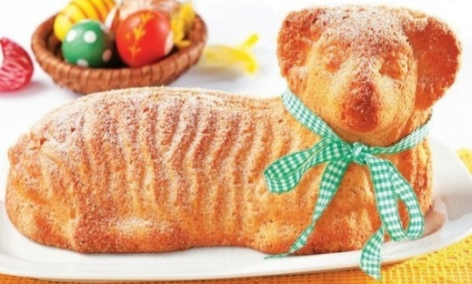
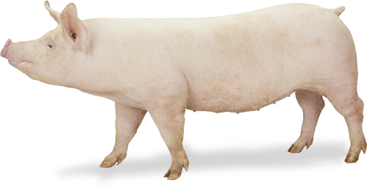
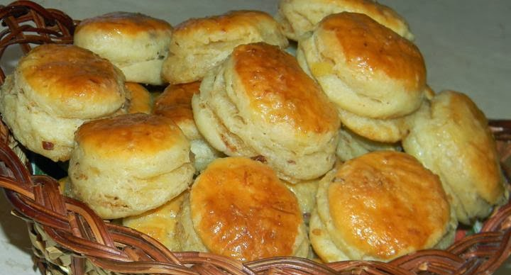
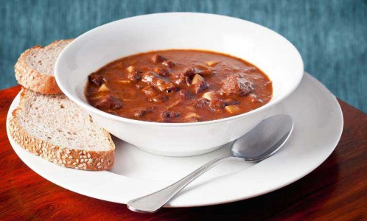
Slovak cuisine
We can find elements of Turkish and Romanian cuisine in it, from the Turks for example we took noodles with curd, strudel, pagáče, tarhoňu, food on skewer, goulash and sausages.
pagáče
goulash

Slide 9
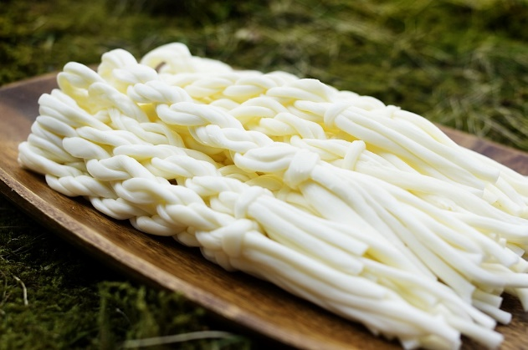
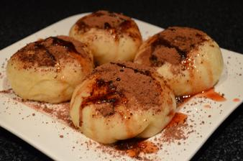
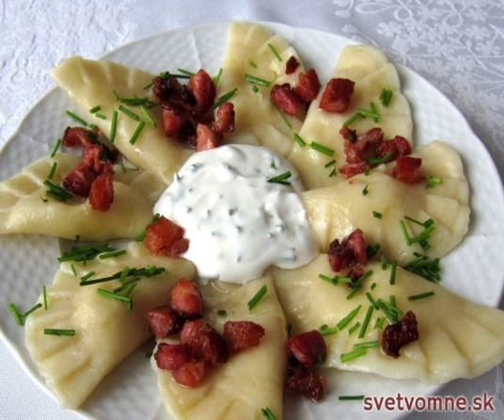
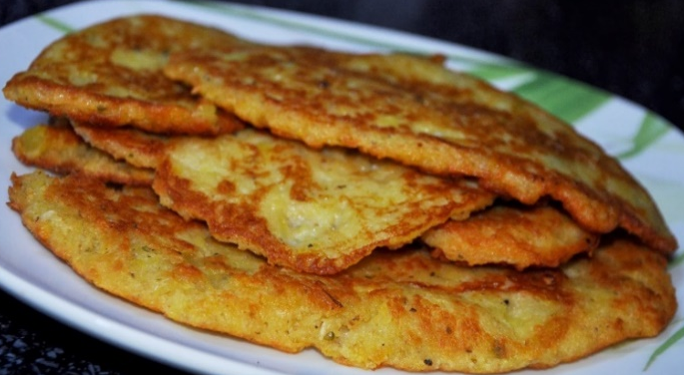
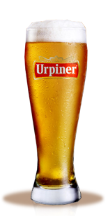
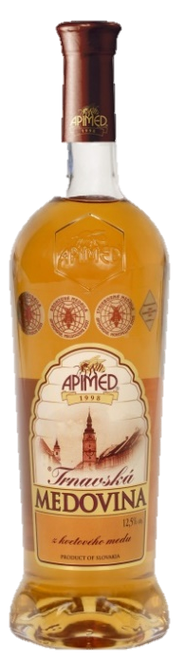
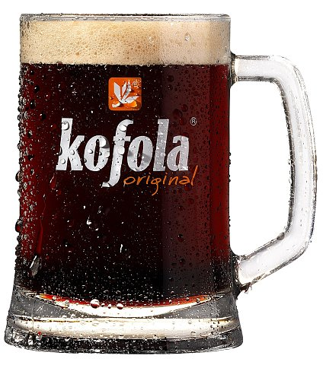
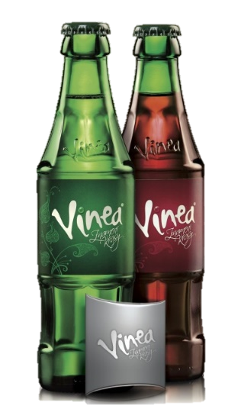
žinčica
syrové korbáčiky
steamed buns
bryndzové pirohy with bacon and cream
potato pancakes

Slide 10
JEDLO
Thanks for your attention
Simona Cabadajová, Jozef Hanuliak, Saša Jánošíková, Timea Krúpová, Tereza Pevná, Michaela Skopalová, Stanislava Somíková, Lukáš Vandlík

